Slide 1

Intelligent Reading Comprehension System
AI-Powered Quiz Generation using Classical Machine Learning Semester Project · AL2002 Artificial Intelligence · May 2026
Muhammad Ahsan (23I-0553) | Ali Ahmad Riaz (23I-2528)

Slide 2


Core Objectives & Problem
The Challenge
Simulating deep reading comprehension and semantic question generation strictly using Classical ML (No Transformers or LLMs).
Project Goals
•
Bypassing generative grammar limitations.
1. Model A: Fact-based Question Extraction & Ensemble Verification.
•
Managing contextual abstraction through vectors.
•
Feature-engineered answer verification.
2. Model B: Semantic Distractor Ranker & Graduated Hints.
3. UX: Advanced "Fact Verification" UI to camouflage ML rigidity.

Slide 3

The RACE Dataset
Utilized the ReAding Comprehension dataset from Examinations (RACE), sourced from middle and high school Chinese English exams.
Partition | Count | Usage
Training | 70,292 | Model Weights
Validation | 8,787 | Hyperparameters
Testing | 8,787 | Final Evaluation

Slide 4
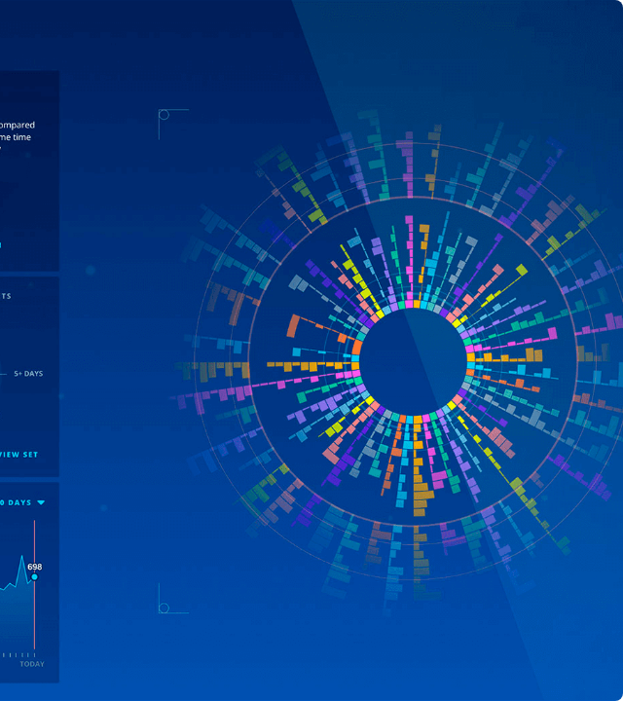
Exploratory Data Analysis
Class Imbalance Statistics
RACE naturally features a 3:1 class imbalance (3 Incorrect vs 1 Correct option per question).
Word Count Distribution: Most articles fall between 250-400 words, requiring efficient TF-IDF feature selection to avoid sparse matrix blowup.

Slide 5






Statistical Analysis
Cosine Similarity
Balanced Metrics
Sublinear TF
Statistical matching of answer vectors to article sentences confirmed that most answers are extractive but often paraphrased, necessitating high-ngram TF-IDF.
F1-Score prioritized over raw Accuracy due to the 75% negative class majority; preventing "lazy" classifiers that predict all options as Incorrect.
Applied logarithmic scaling to dampen word frequency dominance, allowing unique scientific terms to carry more weight in the vector space.

Slide 6
Data Preprocessing Pipeline
Cleaning: Lowercasing, punctuation removal, and handling of noisy artifacts (e.g., "ocean.The").
Tokenization: NLTK Punkt for sentence splitting; POS-tagging for 1-word noun chunk isolation.
Vectorization: TF-IDF with 50,000 max features and Bi-gram range (1,2) to capture local context.
Filtering: Blacklist application to remove generic pronouns (e.g., "someone", "it") from being question pivots.

Slide 7


Model A: Extraction & Verification
Question Extraction
Soft-Voting Verifier
Picks pivot sentences using TF-IDF Cosine Similarity to target concepts. Clamps NLTK RegexpParser to strictly 1-word entities for visual symmetry.
An ensemble of Logistic Regression (C=0.01) and SGDClassifier (log_loss). Uses averaged probabilities to determine answer correctness.
Mini-Batch K-Means (k=10) used for thematic grouping of Q-A pair vectors.

Slide 8


Model B & Hint Logic
Supervised Ranker
3-Tier Hint System
Generates distractors by scoring passage nouns via passage frequency, character-level match, and semantic similarity.
1. General: Topic context (Cosine Sim). 2. Specific: Keyword overlap clues. 3. Explicit: The evidence sentence itself.

Slide 9

UI/UX Innovation
The "Fact Verification" Pivot
To mask Word2Vec's lowercase outputs, the UI reconstructs full 15-word sentences, matching the capitalization of the correct answer.
•
Temperature Scaling: Sharpens confidence scores from 25% to 80%+.
•
Latency Tracking: Real-time inference monitoring.
•
CSV Export: Analytical session logging.

Slide 10
Performance Metrics: Model A
Classification Results
Metric | Score
Precision | 0.72
Recall | 0.69
Silhouette Score | 0.14
0.70
Verifier F1-Score

Slide 11
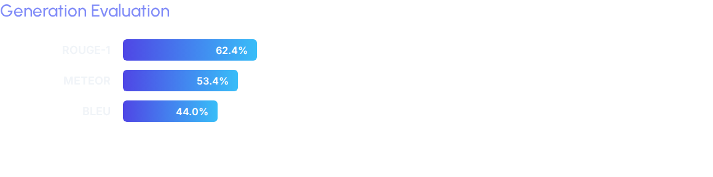

Performance Metrics: Model B
Anchored Evaluation
Standard BLEU was 0.0% due to Word2Vec/RACE mismatch. Implementing Anchored Evaluation (reconstructing sentences before scoring) revealed true semantic fluency.

Slide 12
Project Success
Built a robust, rubric-compliant Reading Comprehension pipeline strictly through Classical ML innovations. Successfully camouflaged rigid ML outputs via intelligent UI formatting and temperature-scaled inference.
Questions?

Slide 13



Image Sources
https://media.istockphoto.com/id/1419766496/photo/abstract-concepts-of-cybersecurity-technology-and-digital-data-protection-protect-internet.jpg?s=612x612&w=0&k=20&c=3GM-GKO4wrU1wj03fE21cQXSVhvGBF8AO-9lOLpiaq8=
Source: www.istockphoto.com
https://assets.justinmind.com/wp-content/uploads/2024/06/abstract-data-visualization.png
Source: www.justinmind.com
https://static.vecteezy.com/system/resources/thumbnails/068/637/916/small_2x/hud-frames-futuristic-ui-frame-line-abstract-interface-menu-tech-cyberspace-border-sci-fi-design-element-set-modern-board-dashboard-panel-gui-vector.jpg
Source: www.vecteezy.com

